Slide 1

Group Discussion
Tilakraj Singh Ranawat

Slide 2
Types
Formal Discussion
These discussions are often part of selection processes, such as job interviews, college admissions, or competitive exams.
Participants are given a specific topic or case study to discuss and are evaluated on their communication skills, knowledge, and ability to articulate their thoughts.

Slide 3
Types
Informal Discussion
Informal group discussions can occur in casual settings, such as team meetings, brainstorming sessions, or social gatherings.
These discussions are more relaxed and may not follow a strict structure, but they aim to exchange ideas, make decisions, or solve problems collaboratively.

Slide 4
Formal Discussion
Do’s:
Prepare: Do your homework and come to the discussion well-prepared with the necessary information or points you want to cover.
Listen Actively: Pay close attention to what others are saying, and show that you're engaged and receptive to their ideas.
Respect Others: Treat all participants with respect and courtesy, regardless of their position or viewpoint.
Stay on Topic: Stick to the main subject of the discussion and avoid going off on tangents.

Slide 5
Formal Discussion
Do’s:
Use Professional Language: Speak in a clear, professional, and respectful manner, avoiding slang or inappropriate language.
Ask Questions: Encourage questions and feedback, as this can lead to a more productive and informative discussion.
Summarize and Conclude: At the end of the discussion, summarize key points and agreements, and clarify what the next steps will be.

Slide 6
Formal Discussion
Dont’s
Interrupt: Avoid interrupting others when they are speaking. Wait for your turn to express your thoughts.
Be Dismissive: Don't dismiss or belittle the opinions or ideas of others, even if you disagree with them.
Monopolize the Conversation: Avoid dominating the discussion. Give others a chance to speak.
Get Emotional: Stay calm and composed. Avoid getting overly emotional, defensive, or aggressive.

Slide 7
Formal Discussion
Dont’s
Gossip or Personal Attacks: Do not engage in personal attacks or bring up irrelevant personal matters.
Assume Intent: Don't assume you know the intentions or motivations of others; instead, ask for clarification if needed.
Lose Focus: Stay on the main topic and avoid getting sidetracked by unrelated issues or discussions.

Slide 8

Group Discussion - Topic based
The Impact of AI on the job Market

Slide 9

Group Discussion - Topic based
How to start?

Slide 10
How to start?
Begin by introducing yourself and welcoming all the participants.
"Good [morning/afternoon/evening], everyone.
My name is [Your Name].
I am glad to start the discussion on “The impact of AI on the job market”.
Express your views
In my view the topic of discussion is interesting and current relevant.
I believe that “Tell about the topic”.
Now, I Invite all of you to participate in the discussion.

Slide 11

Group Discussion - Topic based
How to enter in
debate?

Slide 12


How to enter?
Keep nodding and maintain eye contact.
Say yes, exactly, I agree.
Continue with sentence of other member.
Either you agree or disagree.
Criticize someone’s view if he/she radicalizes.
Friends, we are deviating from the topic.
Ask questions from other member.
Enter when someone in the middle of sentence.

Slide 13
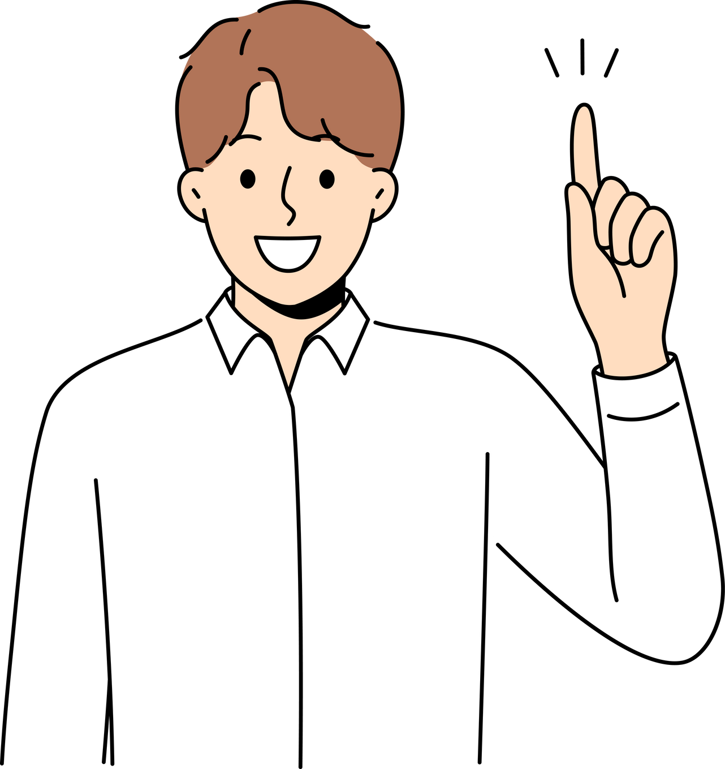
Group Discussion - Topic based
How to conclude?

Slide 14
How to conclude?
Ok Friends, I take opportunity to conclude the discussion.
Friends we had a good discussion and could reach to the consensus.
Friends, though we had a good discussion we could not reach to the consensus.
We were divided on the topic.
Some of them felt that.......
Say the name, he was of the view that........

Slide 15

Group Discussion - Case based
Candidates are presented with a business case or scenario that they must analyze and discuss. They are required to make decisions, solve problems, and formulate strategies based on the information provided. This type of GD assesses problem-solving abilities, critical thinking, and teamwork.

Slide 16
Group Discussion - Case based
Case -1
Imagine you and your friend working in an organization in which your friend has done something wrong. Now if inquiry is instituted against him, he expects you to help him. What is your course of action in this situation?

Slide 17
Group Discussion - Case based
Case -2
You are the HR manager at a mid-sized manufacturing company, and the company has been severely impacted by a recession. As a result, the management has decided to lay off a significant number of employees to cut costs and survive the economic downturn. What steps would you take to handle employee layoffs during a recession while showing care and consideration for the employees and the company's image?

Slide 18
Group Discussion - Case based
Case -3
You work at a mid-sized company, and your boss has suggested a position in a department that you don't want to be part of because it doesn't align with your interests or career goals.
How would you professionally convey your disinterest to your boss and ask for a different department that better matches your career goals?

Slide 19
Thank you!
Tilakraj Singh Ranawat

